Slide 1
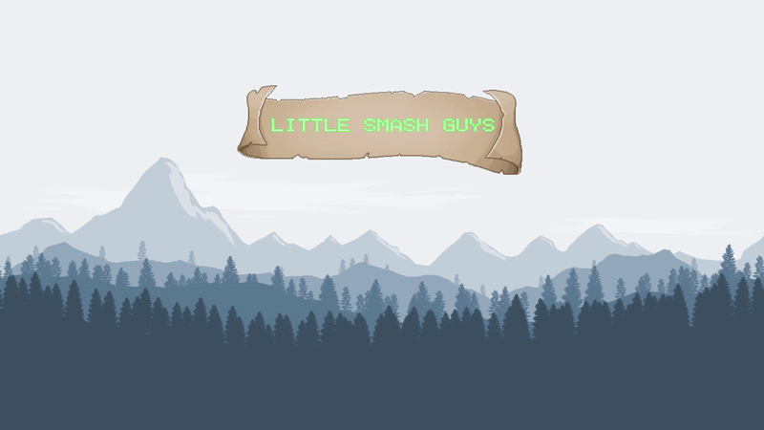
TAP Spring 2019
Ariel Thomas, Anderson Molter, Ephraim Kim

Slide 2
What is the Technology Ambassadors Program (TAP)?
Is an elective where groups of 3-4 students develop educational or demonstrative technology for students K-12.
Is about outreach and participating in events targeted to various groups of students, kids, and the general public.
Is about improving technical, communication, and leadership skills by working on projects and presenting together as teams

Slide 3
Project timeline: Forming groups, discussing ideas, learning
31 Jan. – 28 Feb.
Began and continued work on game. Started with PICO-8. On the 18th, we ditched PICO and moved to Unity.
2–10 Mar.
Spring break
Heavy amount of work accomplished during the break; TAP Expo coming up on 14th
1–17 Jan.
COZMO/Sphero, viewed demos from past teams.
18–29 Jan.
Formed teams, discussed game ideas (arena fighting game, racing game, small arcade games a la tron/snake/etc…)
Settled on multiplayer as a core feature to pursue
18–29 Jan.
Discussed engines: PICO/Game Maker Studio/Unity, researched games and capabilities on the engines
18–29 Jan.
Gave presentation of the game concepts and the engines, received feedback

Slide 4
The TAP Expo, Fixing a broken game
14–22 Mar.
Fixed controls
Fixed attacking system
Fixed respawn system
Fixed level selection and character selection
22 Mar.
Found solution involving rotating a third controller at all times, which allowed two players to play the game
14 Mar.
TAP Expo
Control system broken
Nobody able to play the game

Slide 5
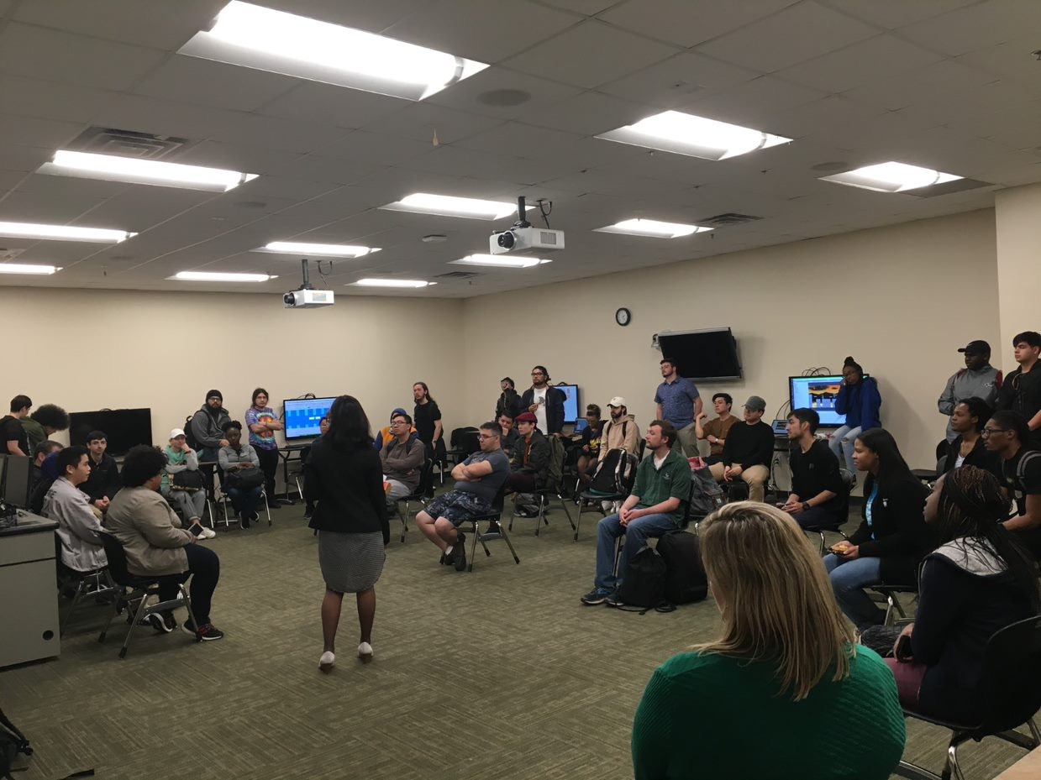
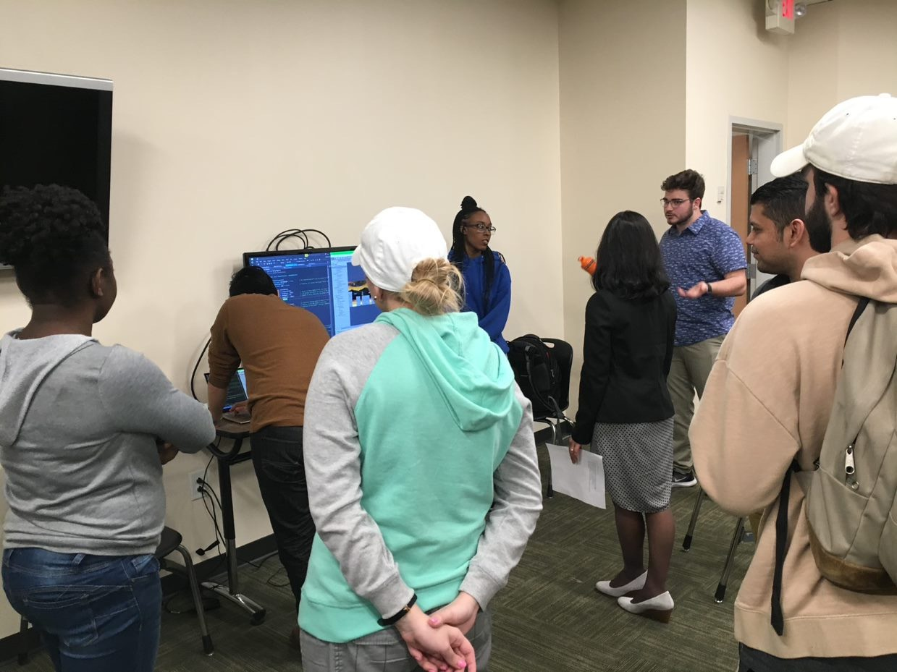
TAP EXPO

Slide 6
Atlanta Science Festival, a new control system, and finding success
23 Mar.
Atlanta Science Festival
14 commits since 14th
Huge success. Universally enjoyed by kids (approx. ages 7-13).
23 Mar.
Few more bug fixes
Got a new control system called Rewired from Unity Asset Store; this enabled four player gameplay
10 Apr. and 13 Apr. (STarS and S3)
First time we got four players to play the game (original idea)
Huge success with the middle schoolers

Slide 7
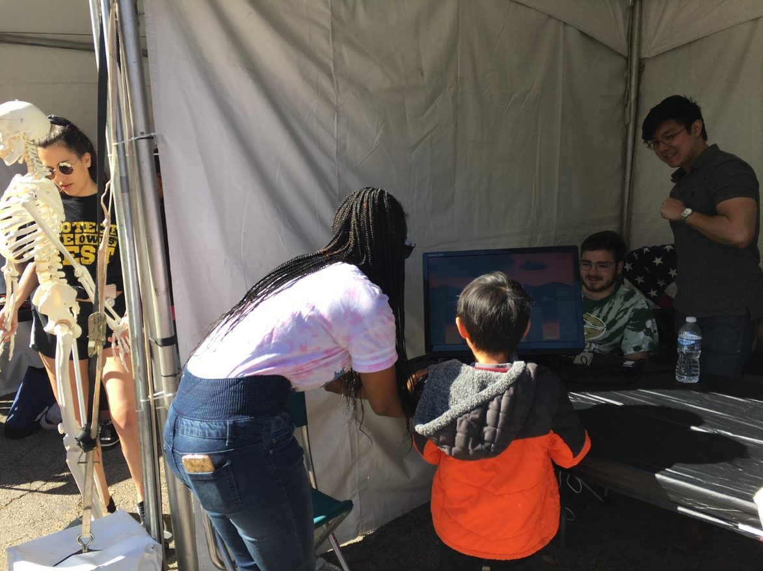
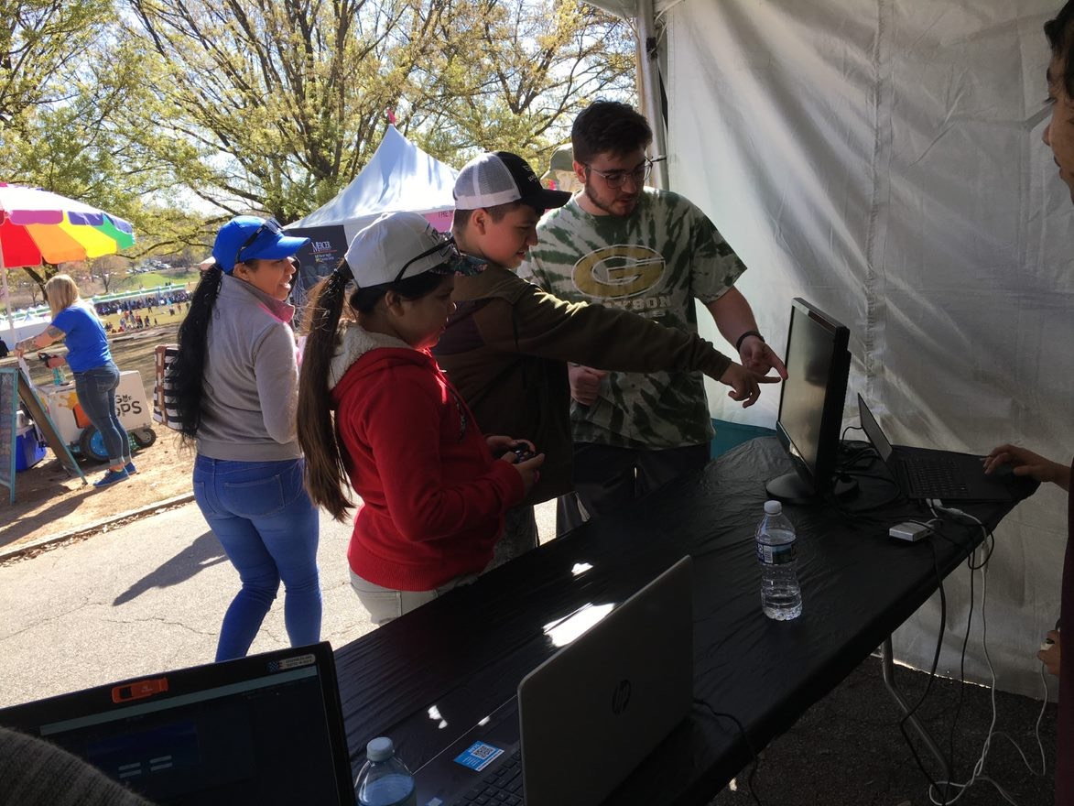
ATLANTA SCIENCE FESTIVAL

Slide 8
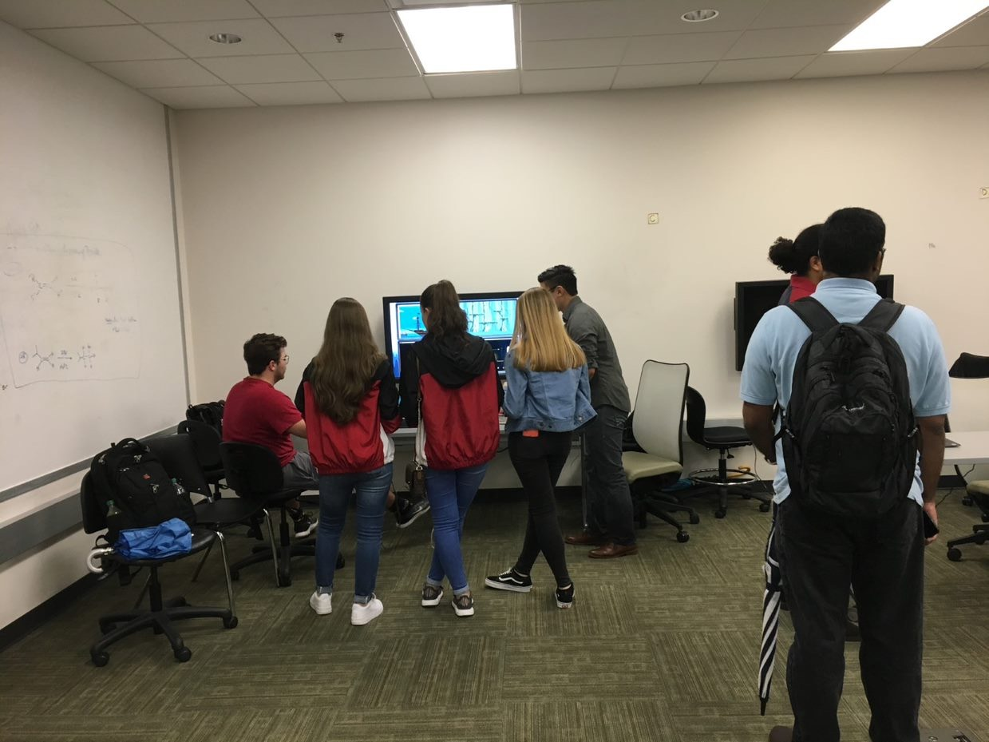
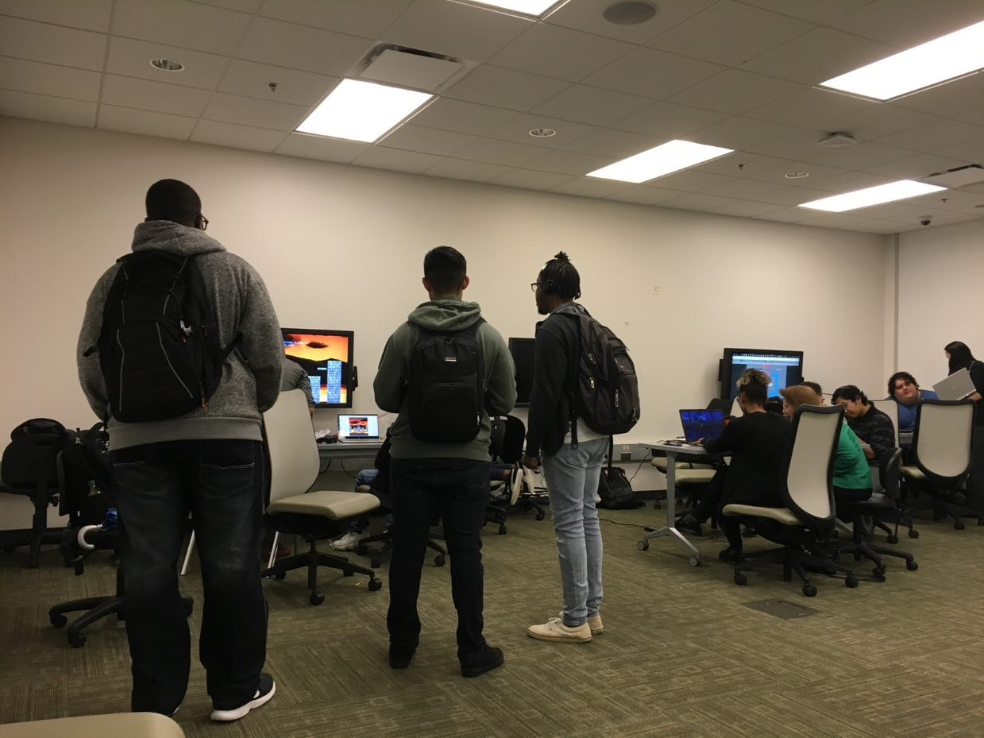
STARS Event

Slide 9
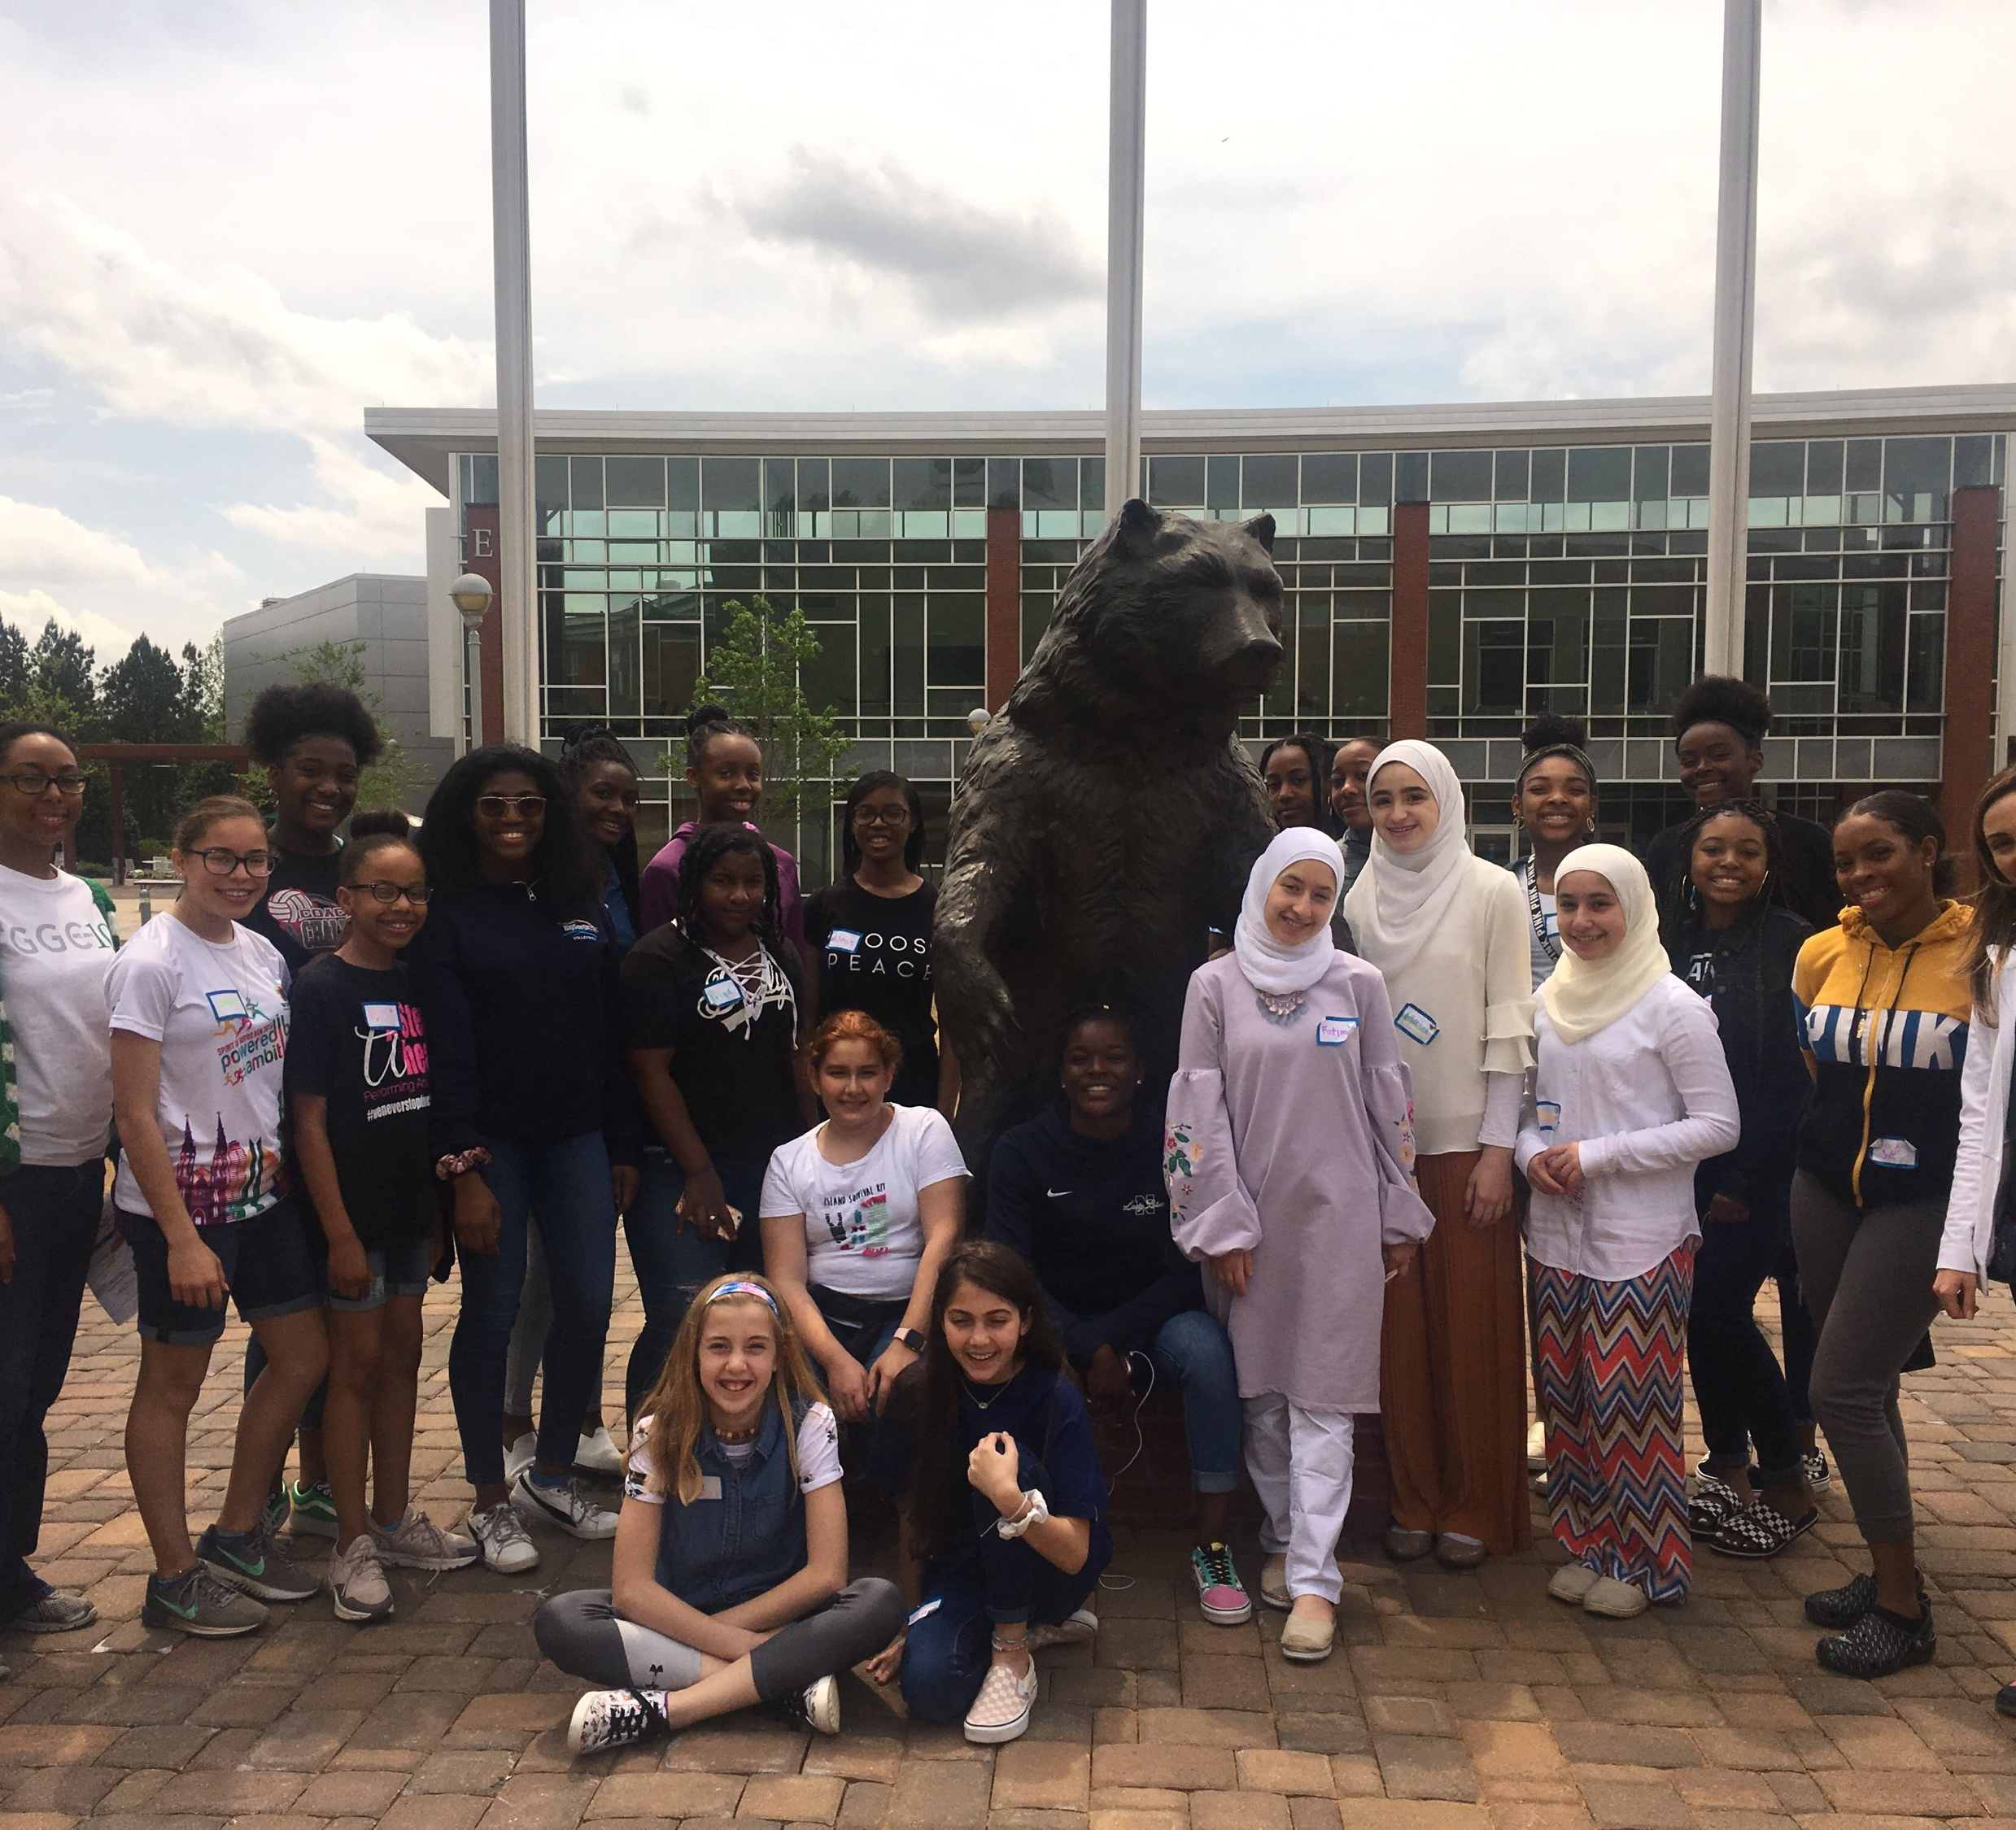
Super Saturday Series (S3)

Slide 10
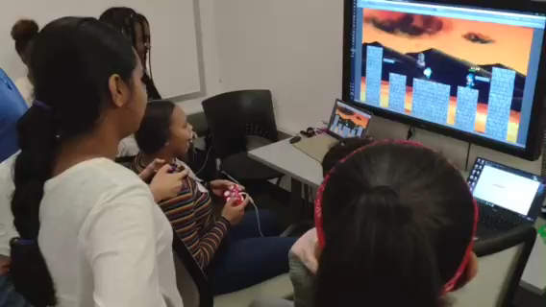

Slide 11
Technologies

Slide 12
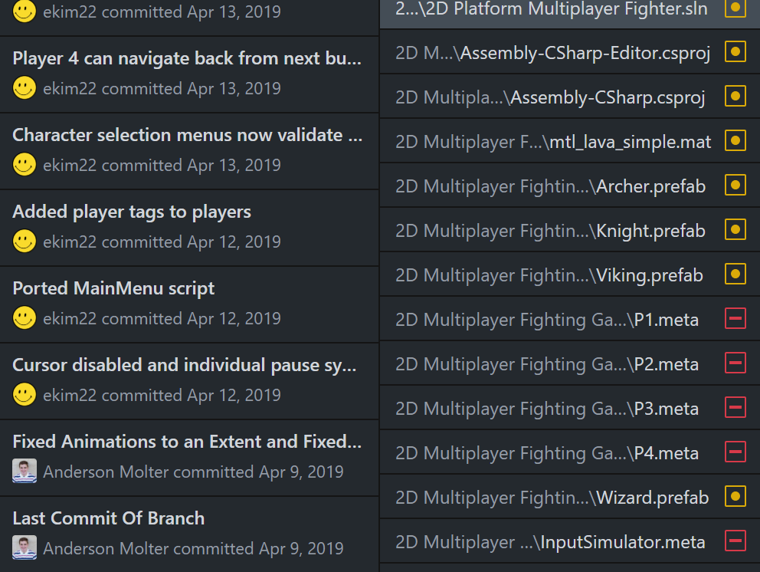
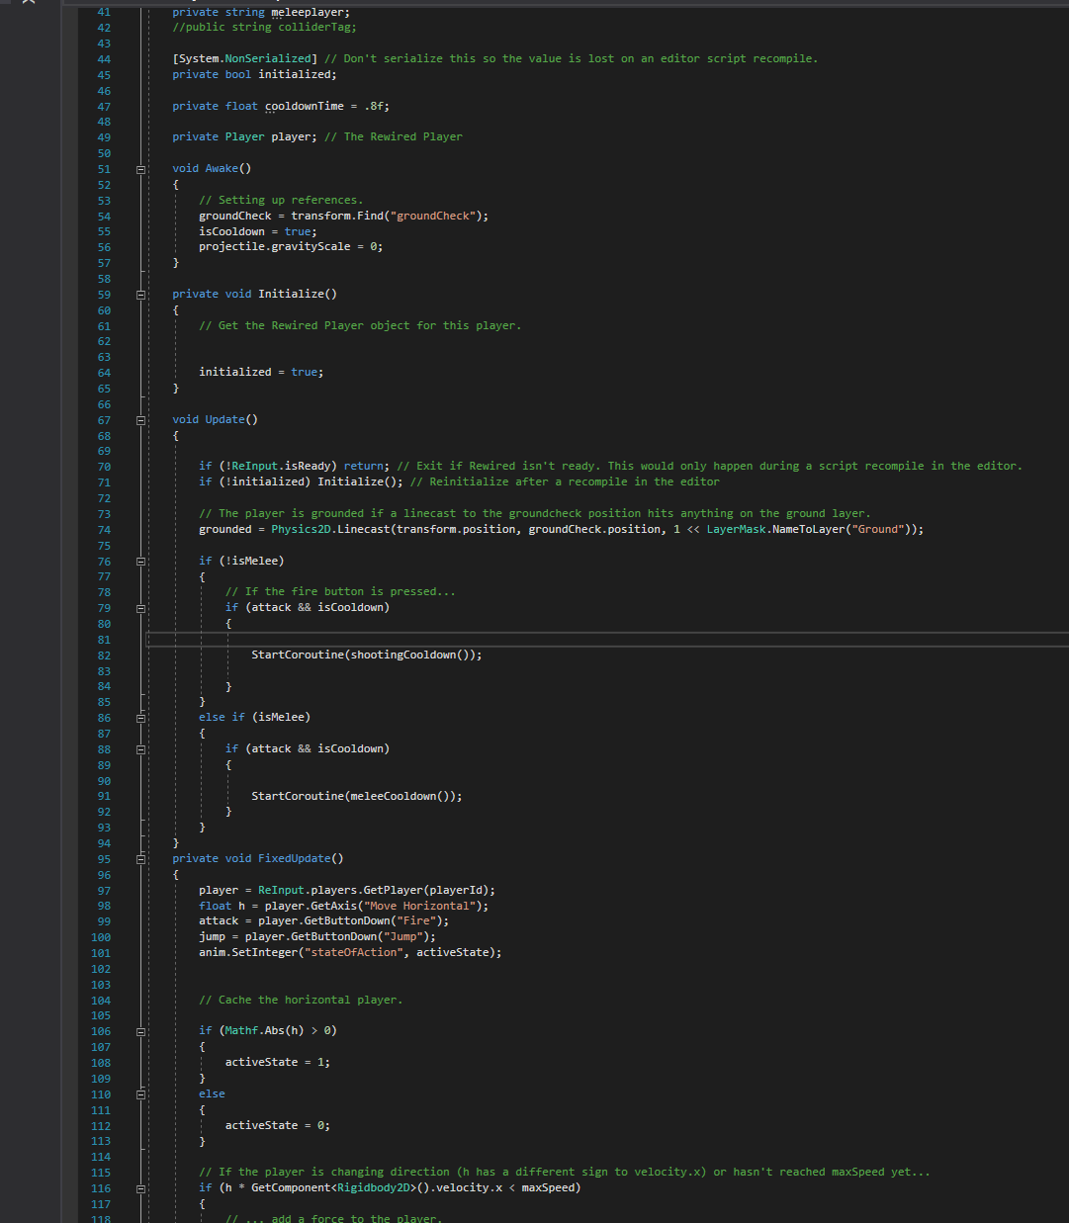
Technologies
C# and Visual Studio for coding
GitHub for organization and version control

Slide 13

Visual Studio IDE
Free Development Platform for C#, C++/CLI, Visual Basic .NET, F#, JavaScript, XML,XSLT, HTML, and CSS.
Made by Microsoft
Allows users to make Native Windows Applications for Windows Store.

Slide 14
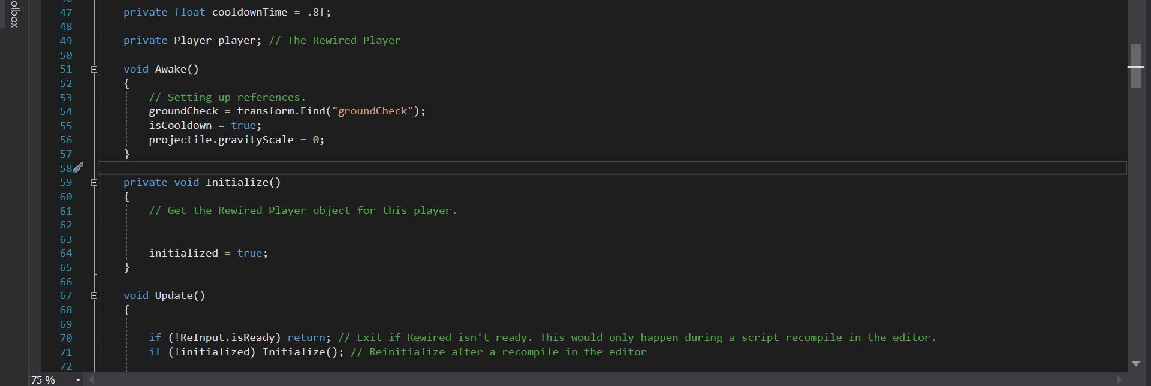
C#
Microsoft’s “Java”
The syntax of C# language is similar to the C-style family like Java, C, C++.
C# and XAML are the main language used to develop Windows Store Apps.

Slide 15
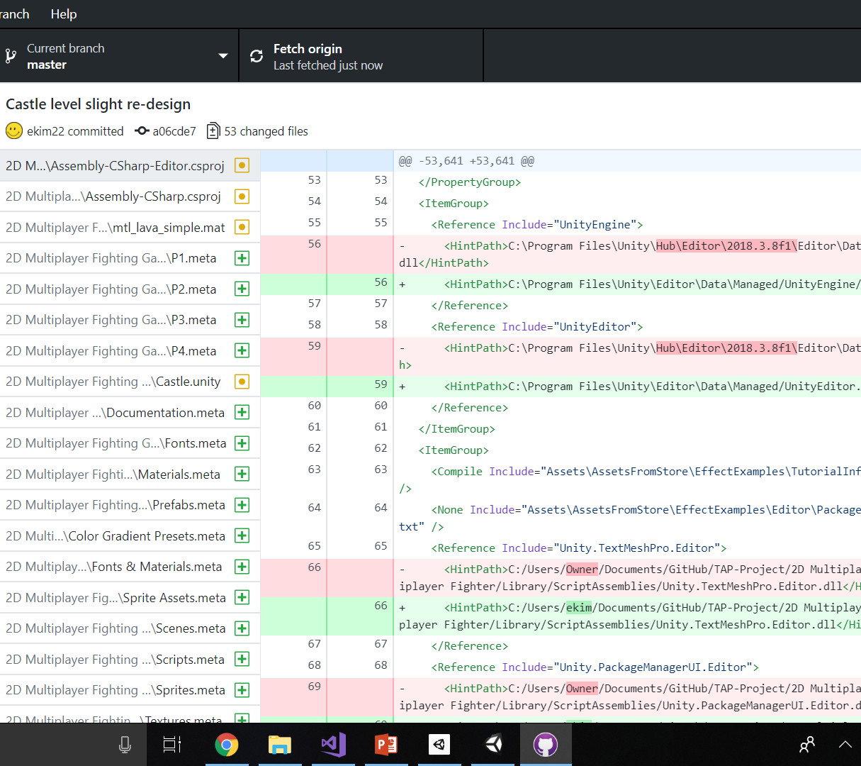
GitHub
Provides professional repository services for project collaboration.
Free Pro account with Student Email.
Makes merging versions of software a breeze (usually).

Slide 16
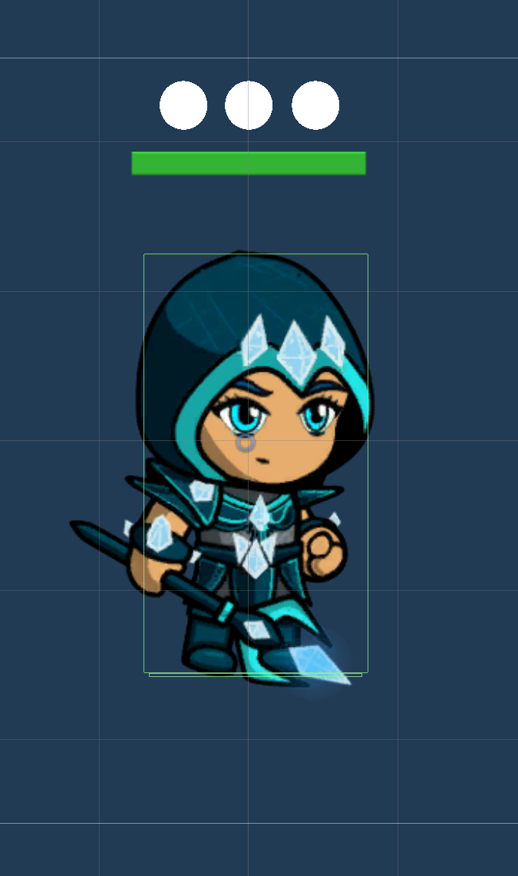
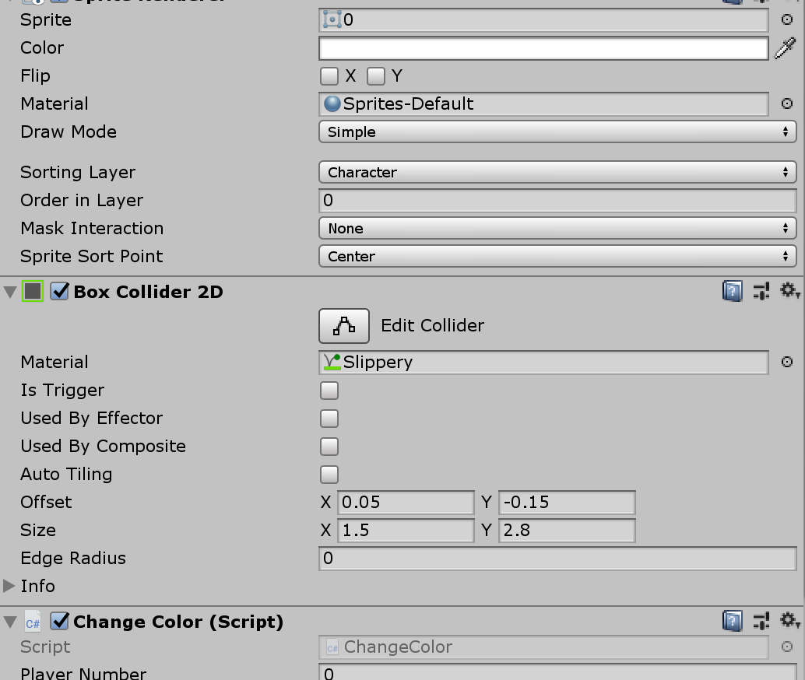
Prefabs and Components
Prefabs are a way to reuse GameObjects
Components are attributes on GameObjects and a way to manage their properties and additions.

Slide 17
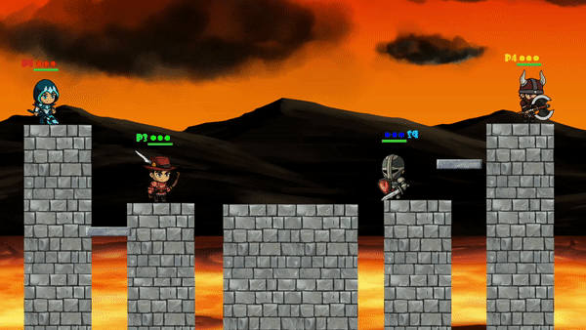
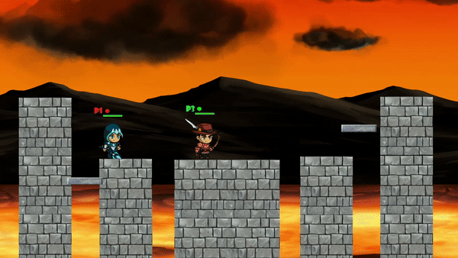
Gameplay

Slide 18
Workshop Tutorials

Slide 19
Introducing Digital Media and ITEC 1001 classes to Unity and Coding
Ruby’s 2D Adventure, a beginner’s tutorial endorsed by Unity
Major activities:
Setting up a new Unity project
Learning about GameObjects through adding a sprite
Getting acquainted with real code and developing movement logic to the sprite.
Adding components to a GameObject using the inspector feature

Slide 20
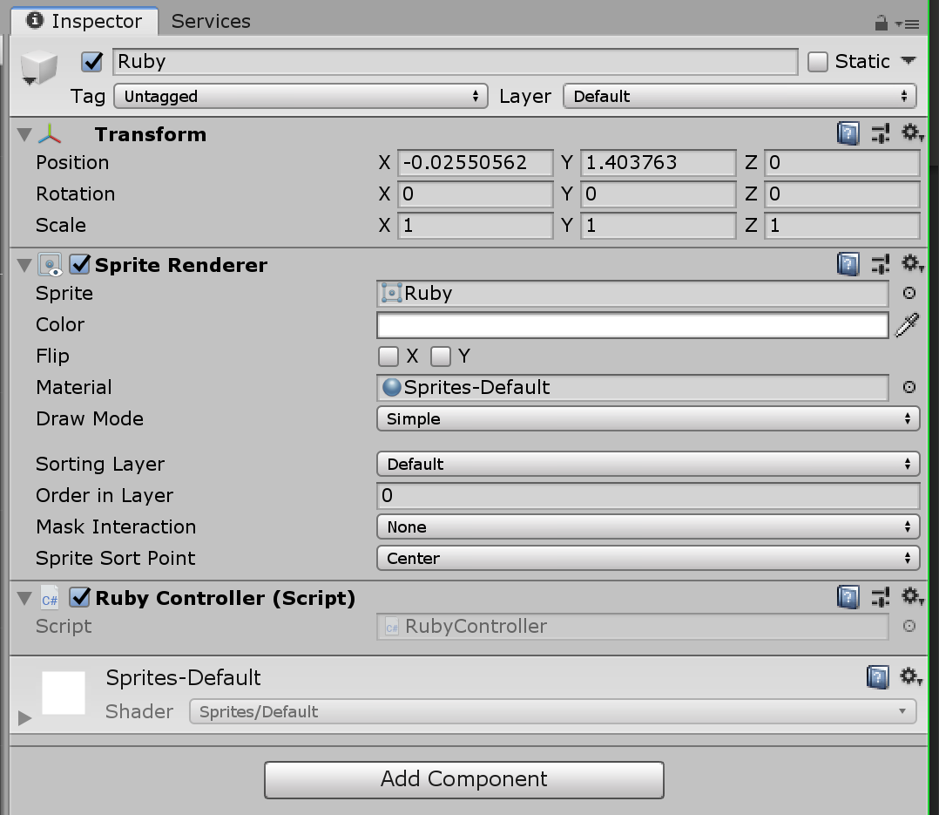
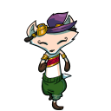
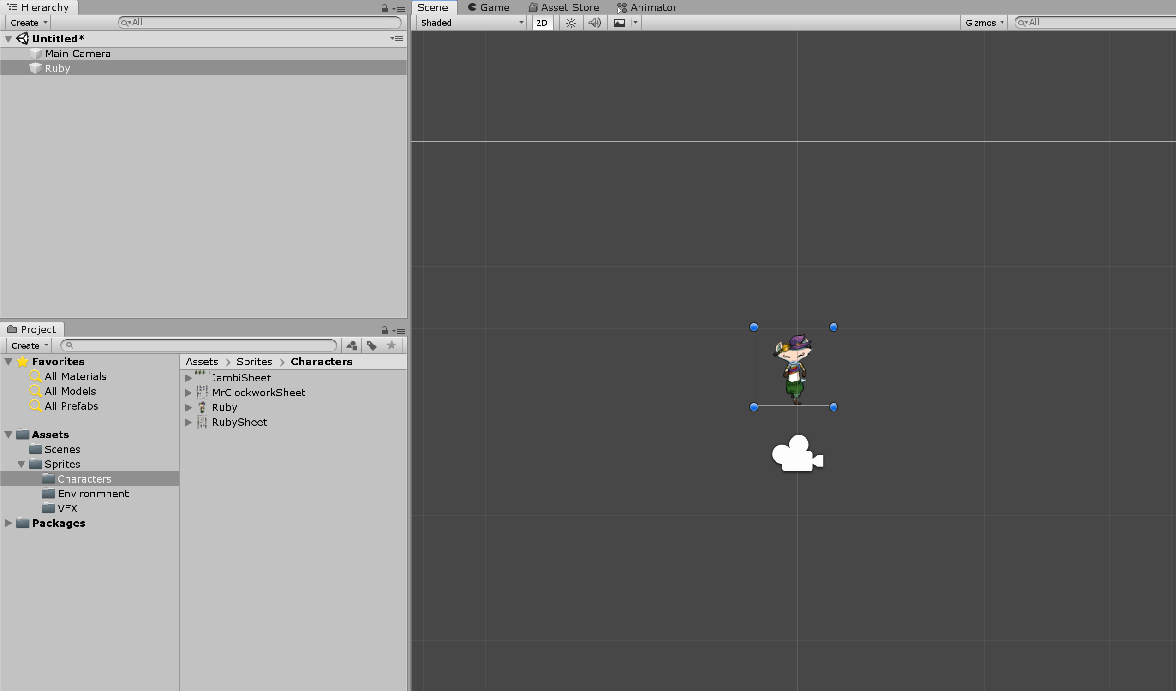
First Tutorial
Ruby Sprite (top left)
Editor, scene view, hierarchy of gameobjects (bottom)
Inspector, components (top right)

Slide 21
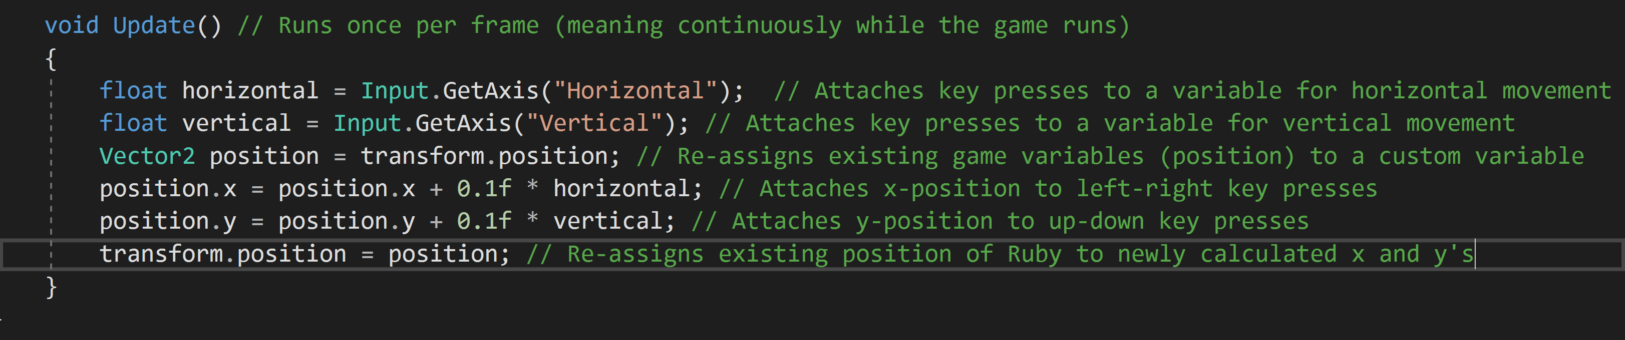
Ruby’s code (movement)

Slide 22
Second Tutorial
Similar to first
Avoided spending time on how to create a Unity project
Avoided importing project assets from a download directory (assets preloaded into a pre-existing project)
Simpler movement controls (moving up against gravity, no horizontal movement)
Theoretically easier to get a game going

Slide 23




Plane, background, a couple sharp rocks
Click and drag to scene to make them gameobjects
Write code
Add code as component
Modify values in inspector as we go along

Slide 24
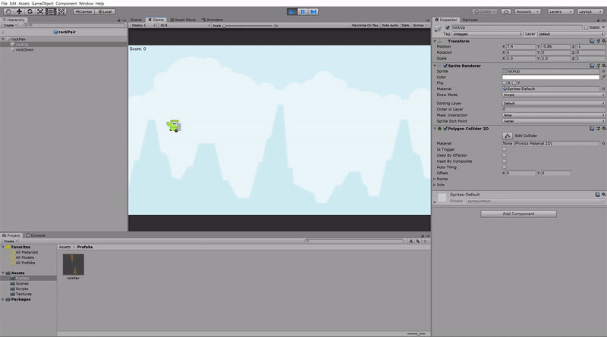

Slide 25
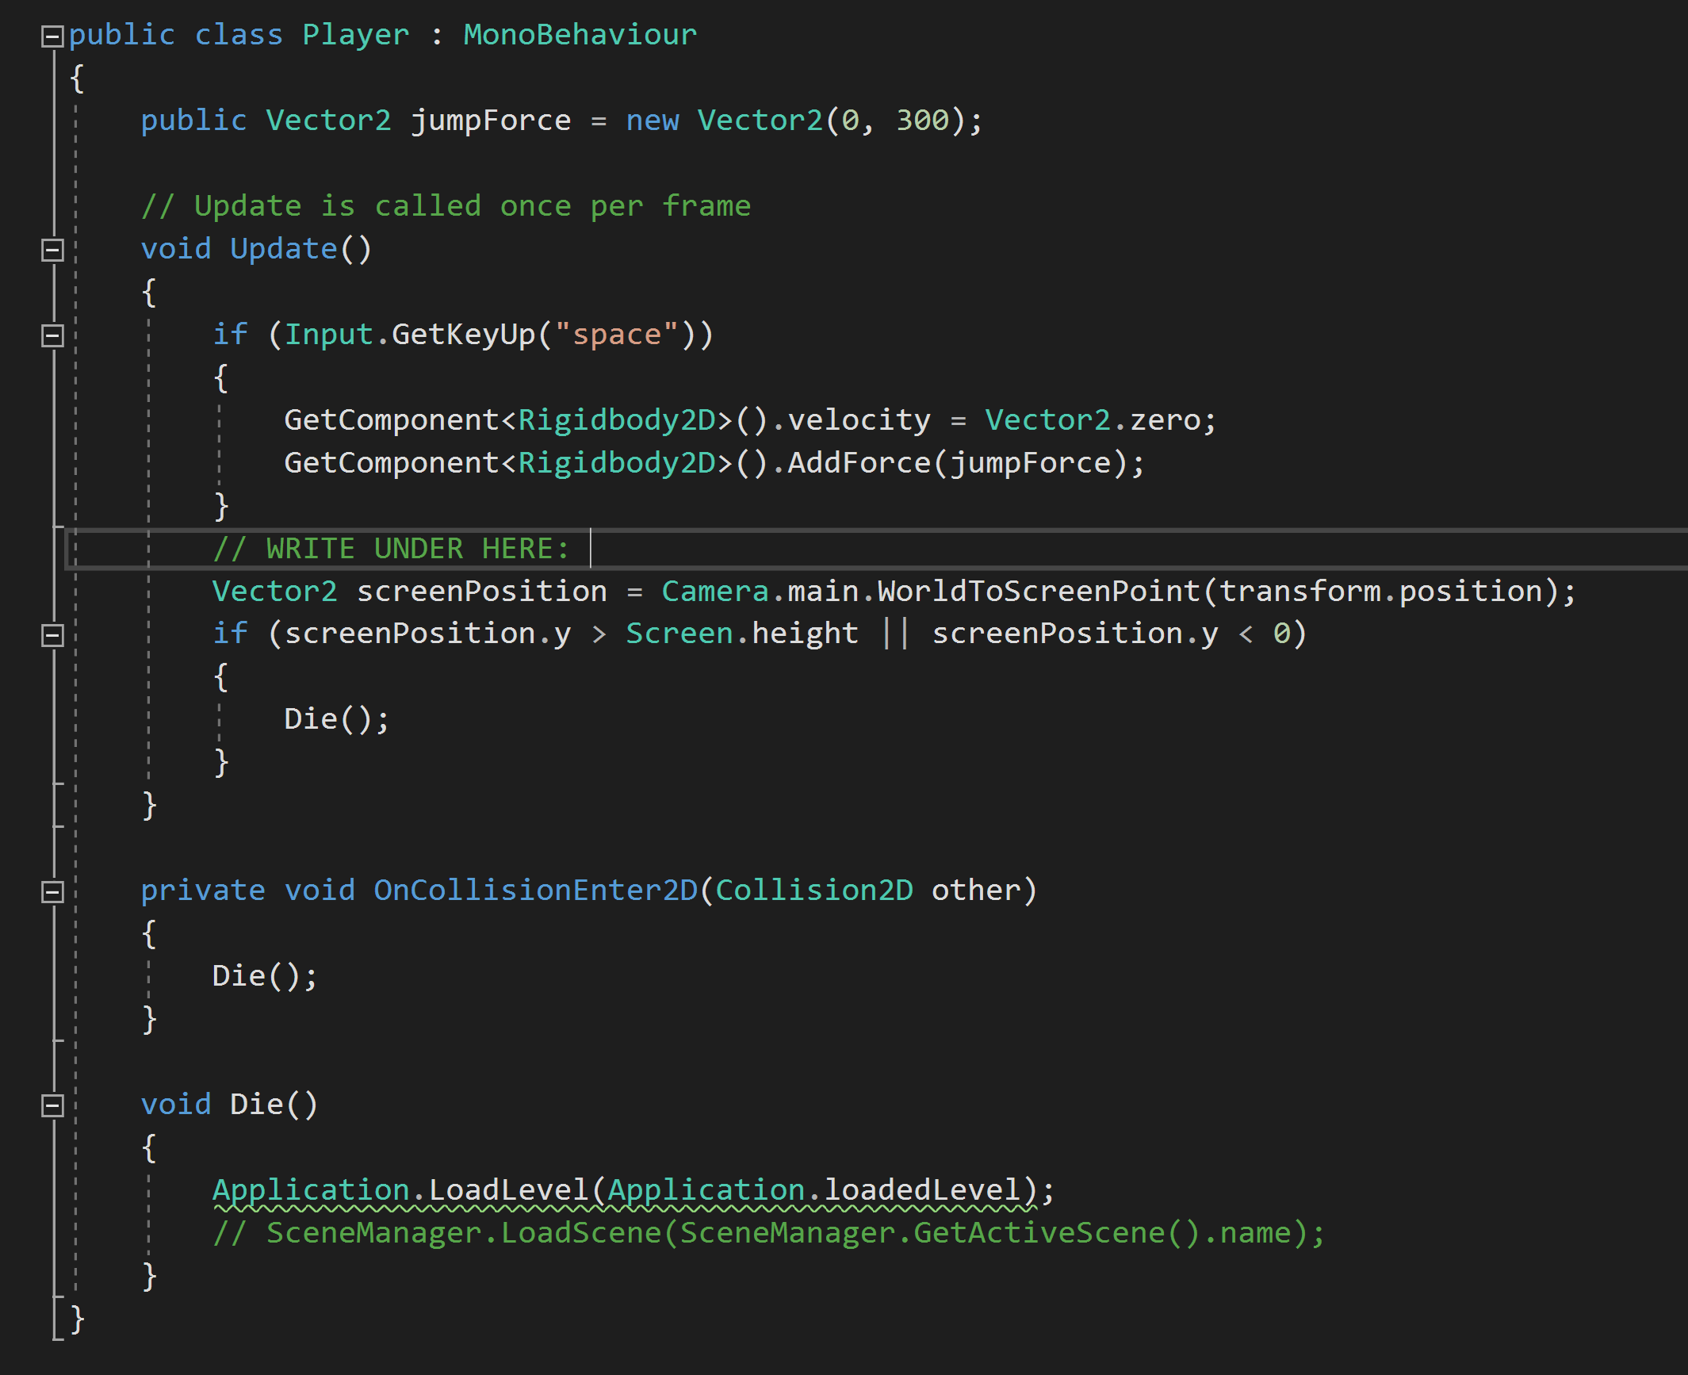
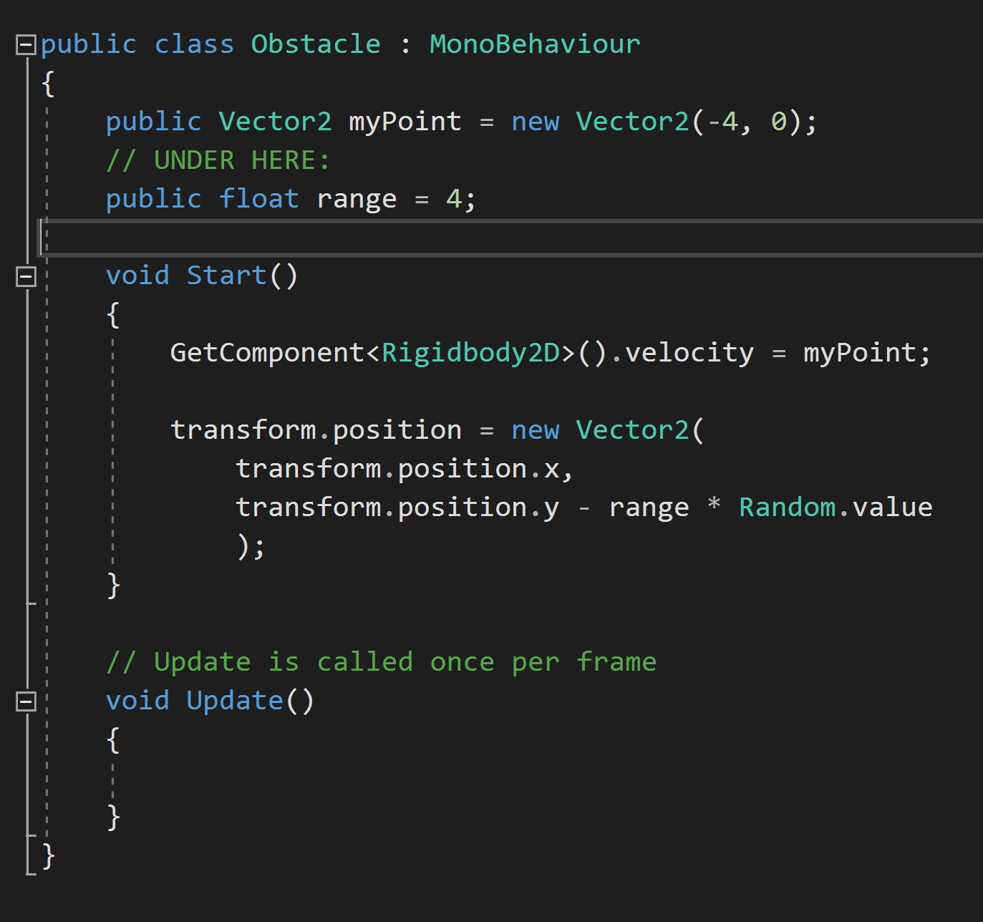
Player.cs / Obstacle.cs

Slide 26
Workshop Ratings and Feedback

Slide 27
Demographics
Wide variety of majors
Business
Nursing
Criminal Justice
Education
Psychology
Biology
Film
Information Technology / Digital Media
36 total responses
22 female / 14 male
About a third Asian / Pacific Islander, a third Caucasian, a last third almost equally comprised of African American and Hispanic/Latino students.

Slide 28
Overall Experience 5 – stars: 22 4 – stars: 12 3 – stars: 1 2 – stars: 1

Slide 29
Workshop Engagement 5 – stars: 21 4 – stars: 11 3 – stars: 2 2 – stars: 2

Slide 30
Learned something new Yes: 35 No: 1

Slide 31
Made more curious about programming and IT? Yes: 19 No: 17

Slide 32
“What did you like most about the workshop?”
From the high ratings
“The game was super fun”
“Playing the game they created”
“The way they presented”
“The students themselves”
From the low ratings
“Seeing that coding isn’t as difficult as it looks”
“Four player game”

Slide 33
“Are there any changes you would recommend to improve the workshop?”
From the high ratings
“None at all, just not a timeline”
“No! Nothing”
“Recommend them to go a bit slower when explaining and walking us through the coding process”
“More time playing the game and making your own changes. ”
From the low ratings
“More time or to move faster. Maybe have a file with the code already written in it for the example so that it could be copied.”
“Less information”
“Wish they were more prepared when it came to presenting”
“Slow down a little bit”

Slide 34
Lessons Learned

